Slide 1

What does a Master's Degree Program in Content Strategy
Look Like?
Irene Michl, Heinz Wittenbrink

Slide 2
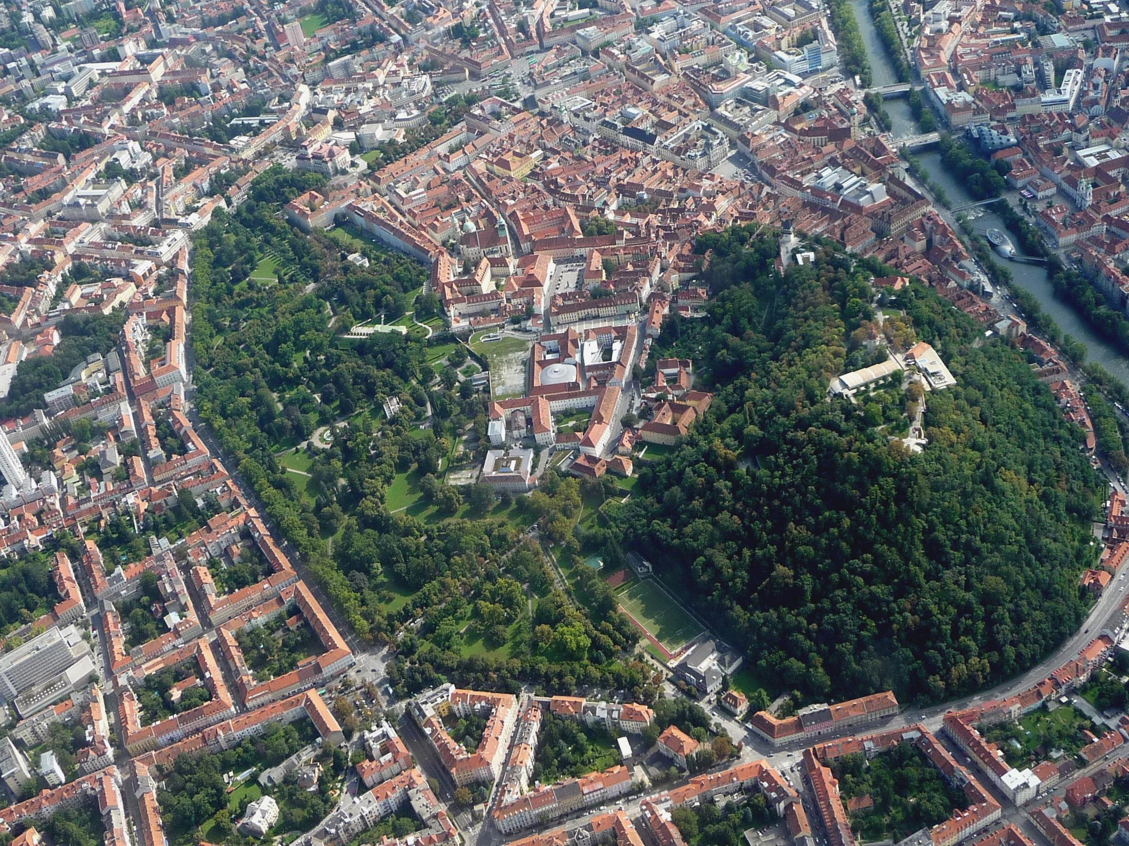
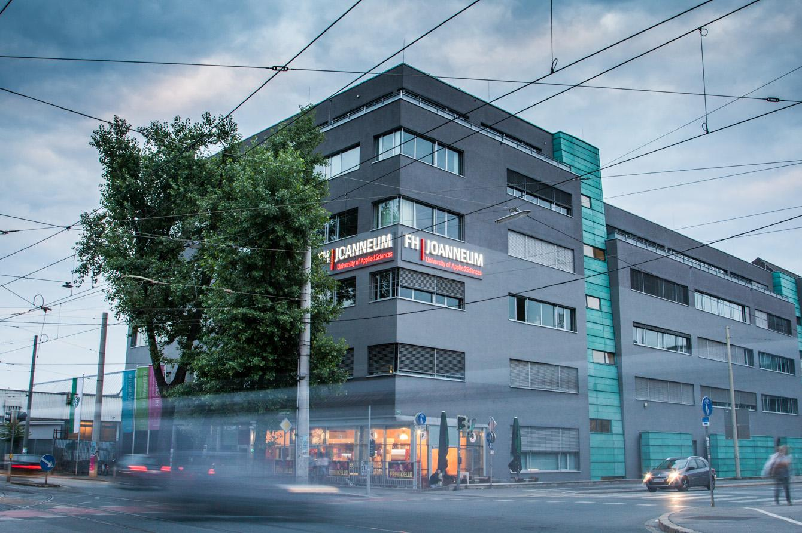

Studying content strategy in Austria
Notes:
CreditsW Wikimedia Foundation https://commons.wikimedia.org/wiki/File:Historic_City_Center_of_Graz.jpg 8th Austrian UAS Language Instructors' Conference http://lic.fh-joanneum.at/

Slide 3
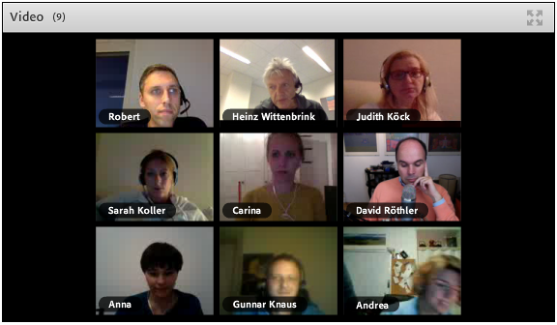
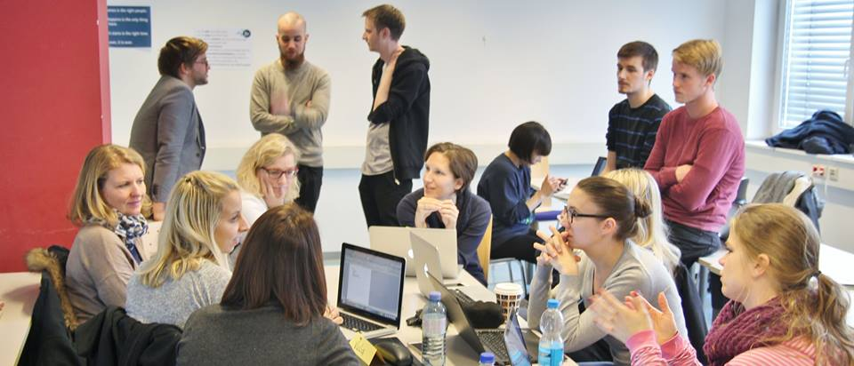
Working and
studying

Slide 4

Collaborative online learning
Slack
Trello
Google drive, docs, spreadsheet, presentation
Zotero
Google hangouts / Adobe connect
Skype
(Facebook group)
OER Blog, portfolios

Slide 5
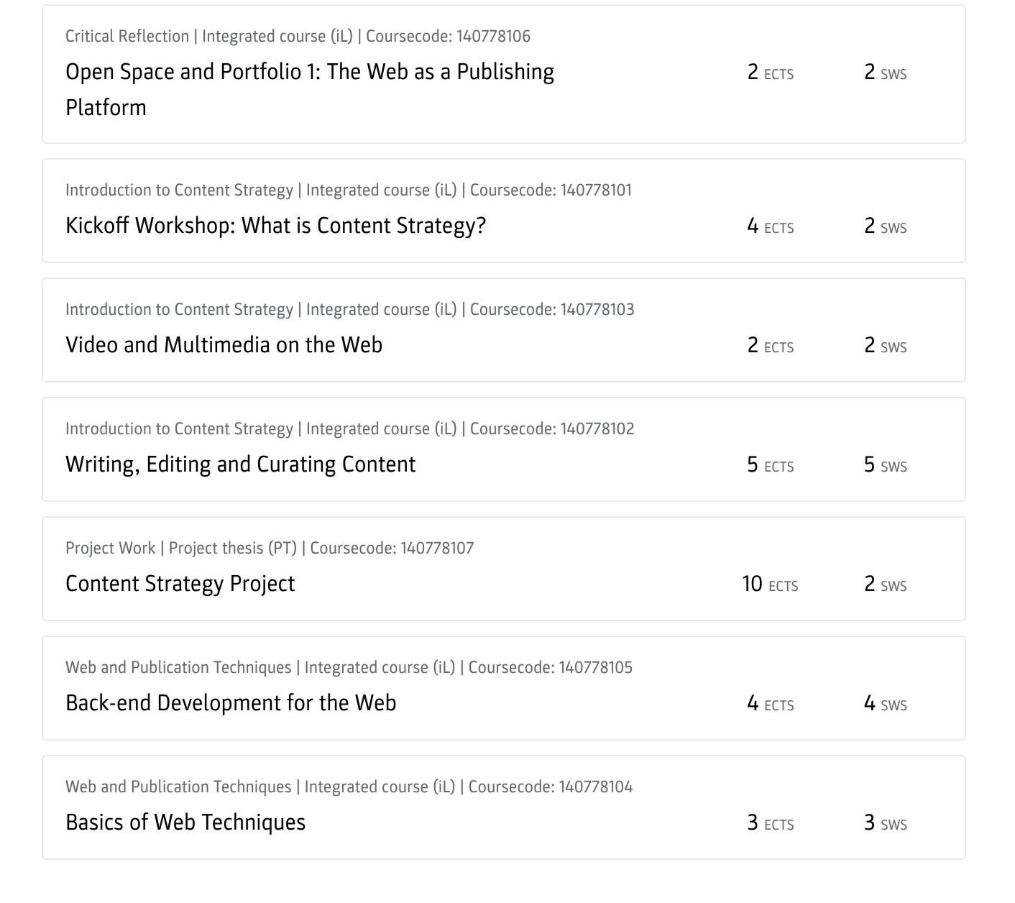
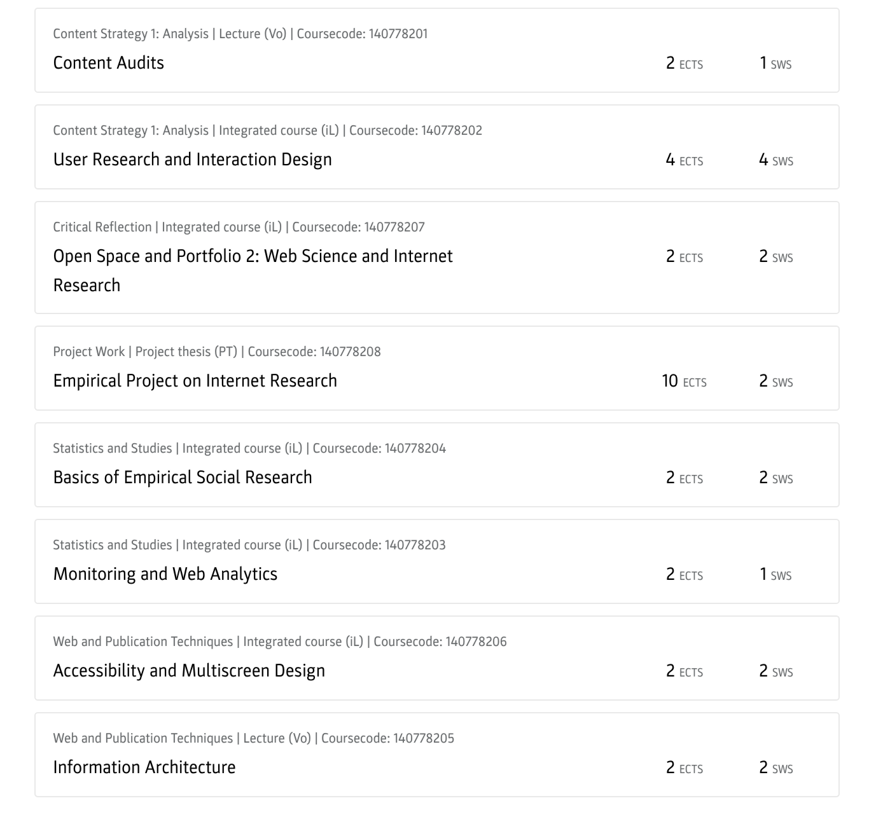
Semester 1 + 2: basics, analysis

Slide 6
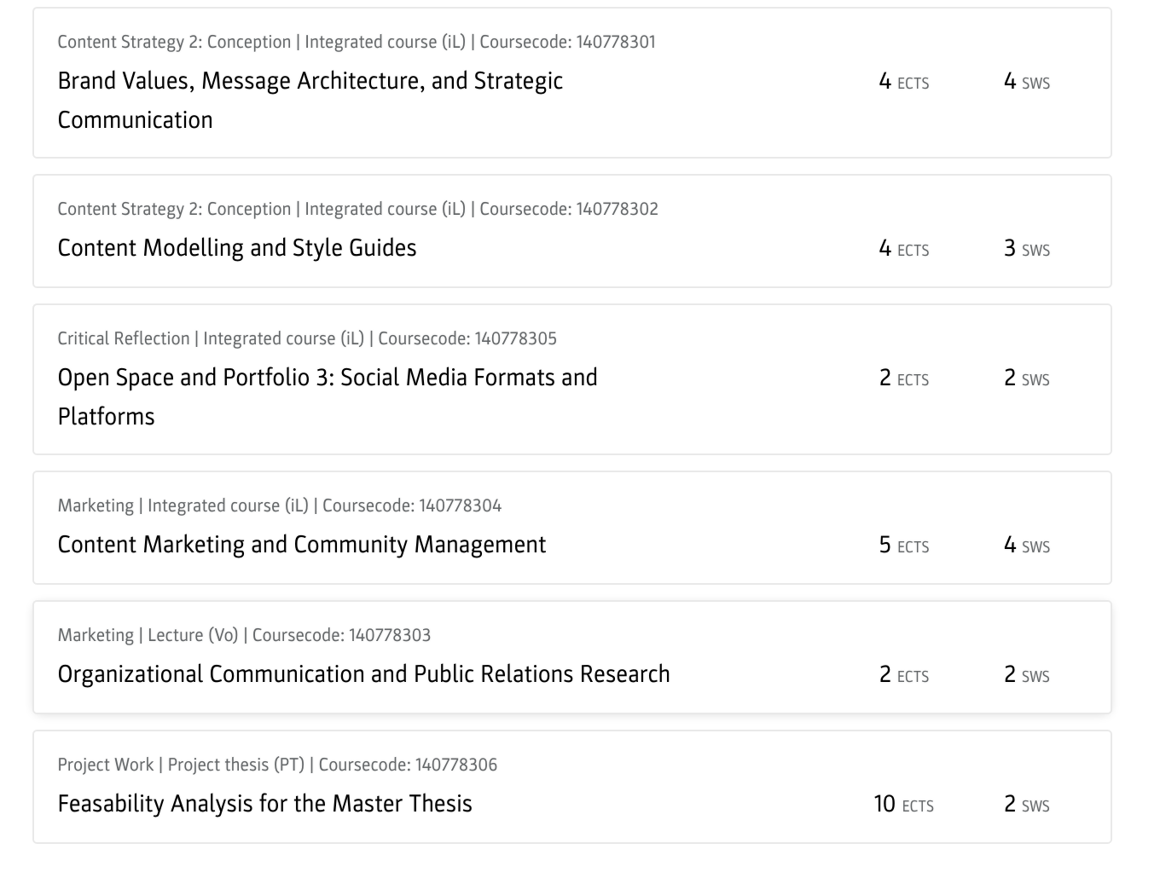
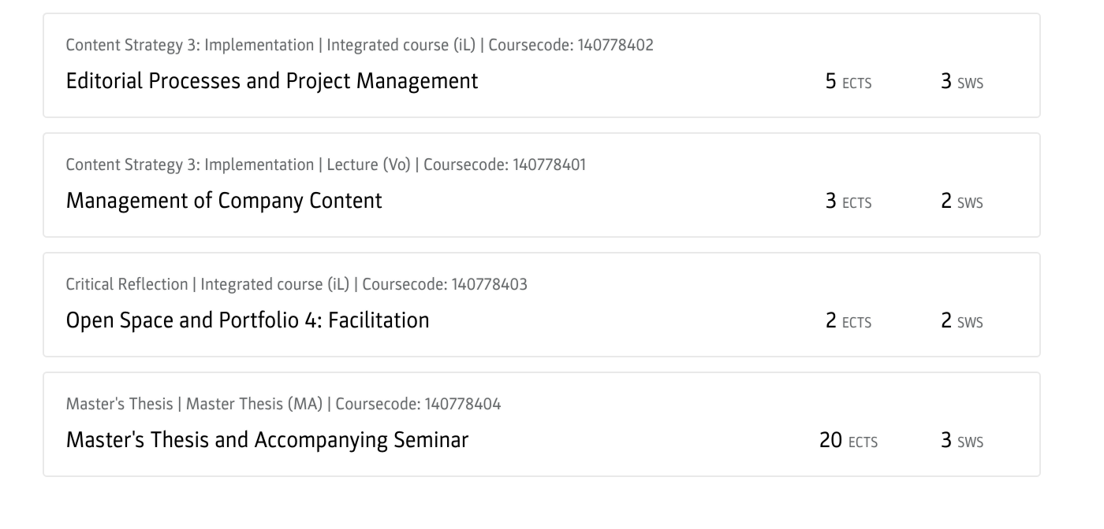
Semester 3+4: strategy, implementation

Slide 7
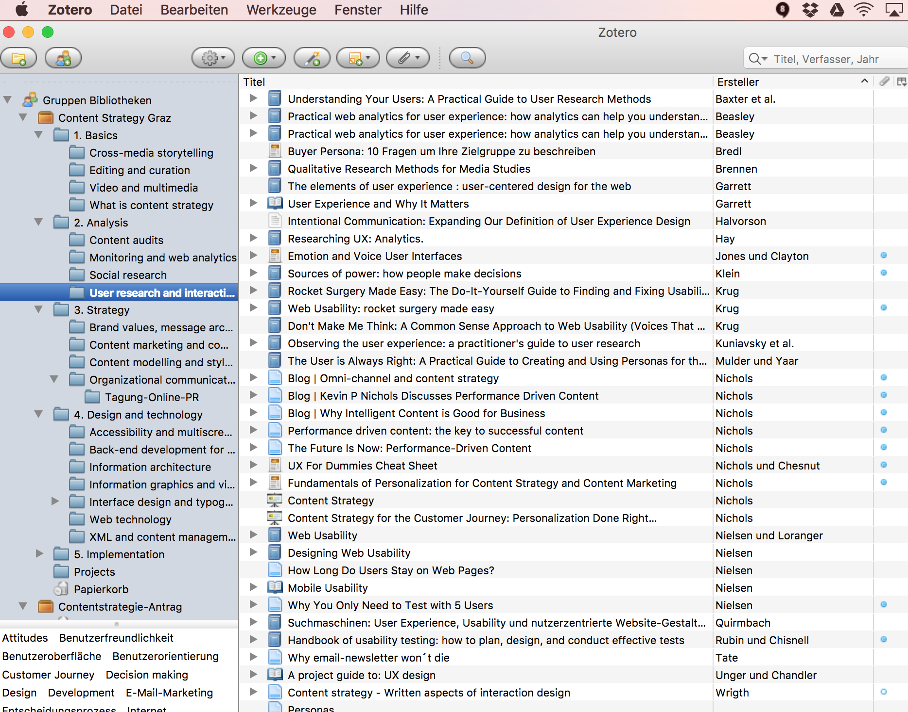
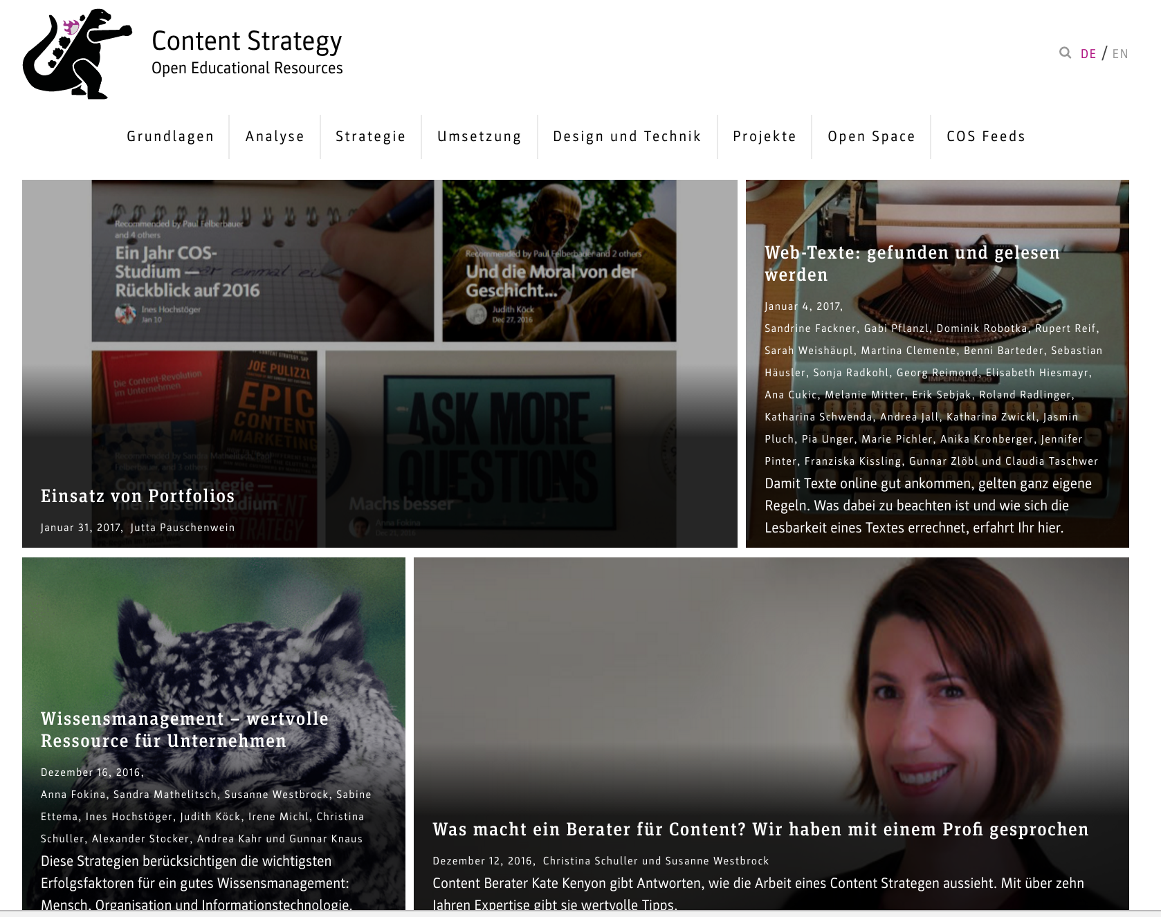
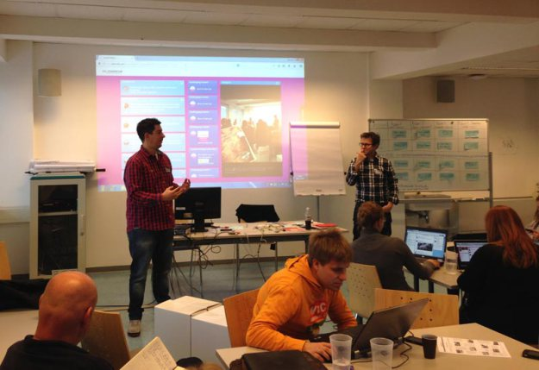
Open knowledge

Slide 8
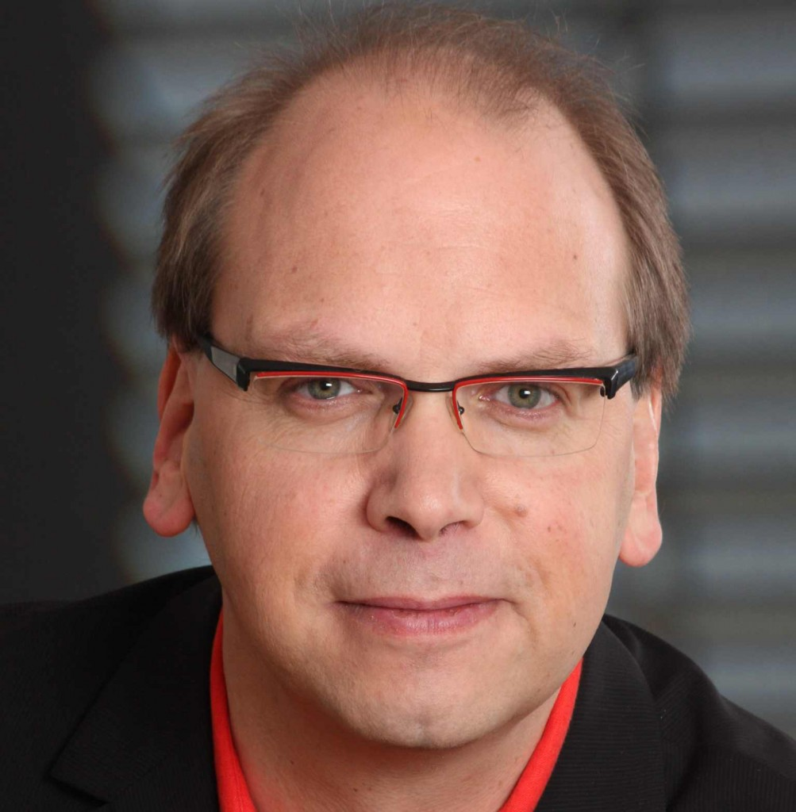
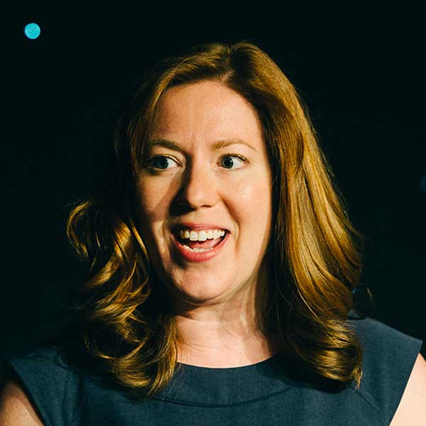
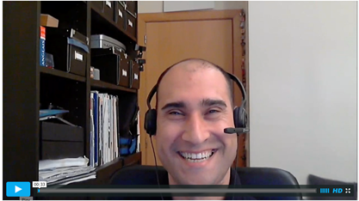
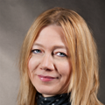
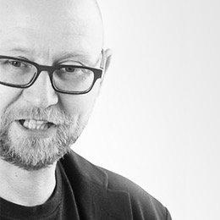
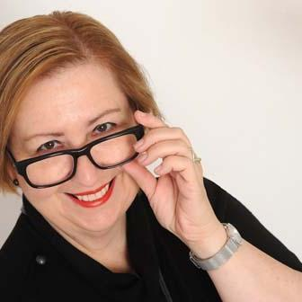
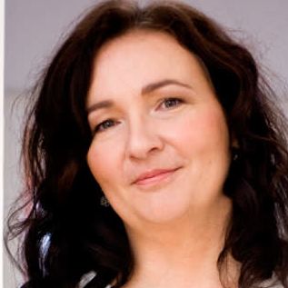
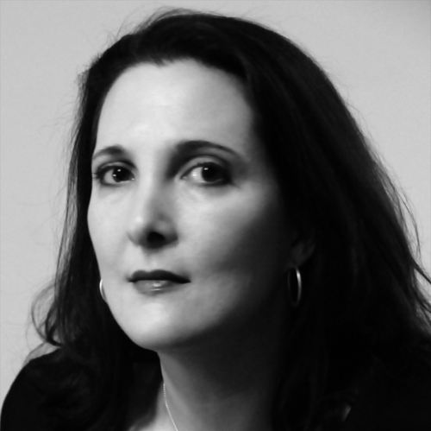
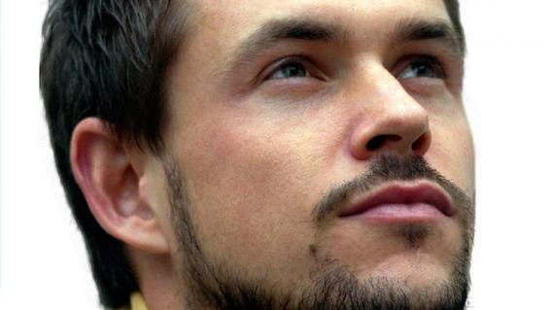
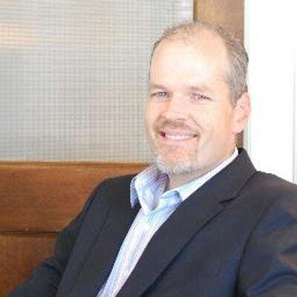
Lecturers from diverse backgrounds

Slide 9
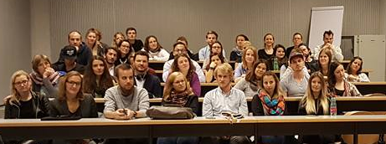
Students from diverse backgrounds

Slide 10
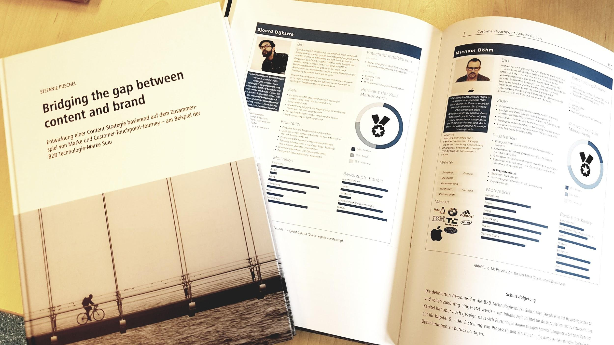
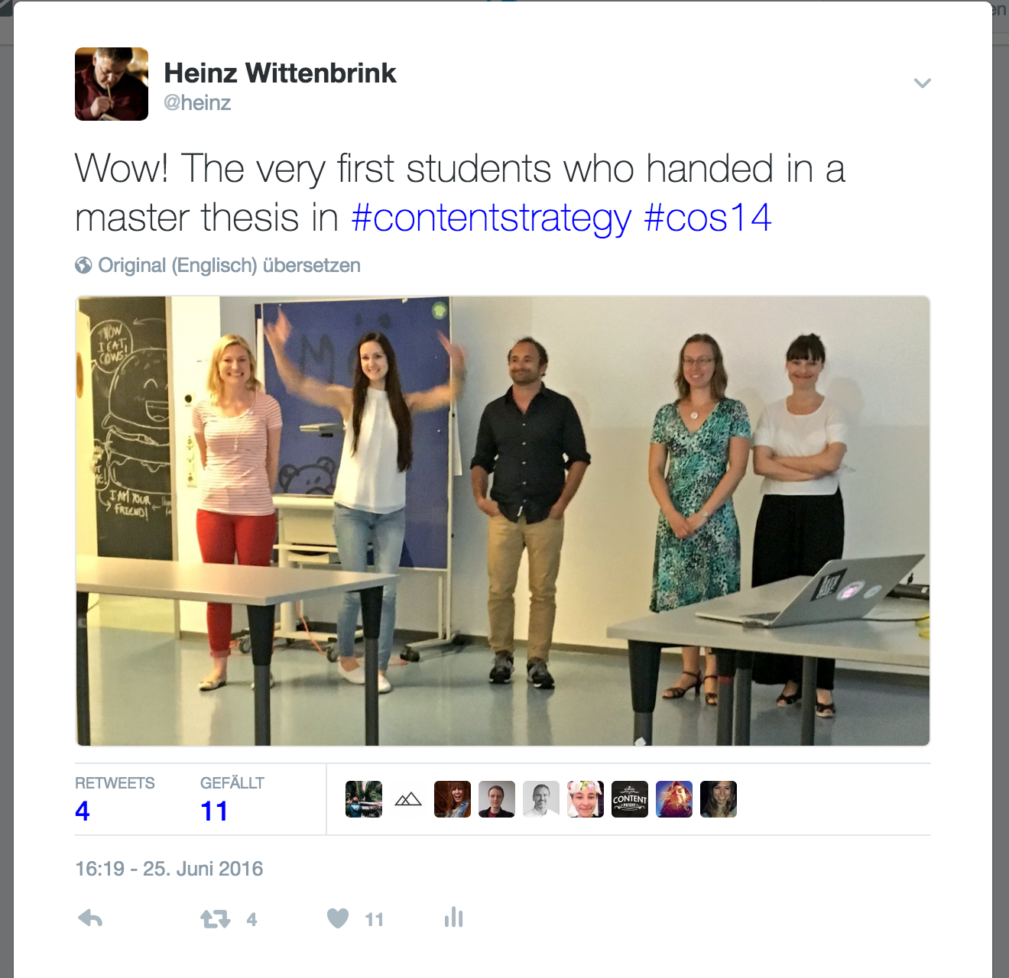
Master theses

Slide 11
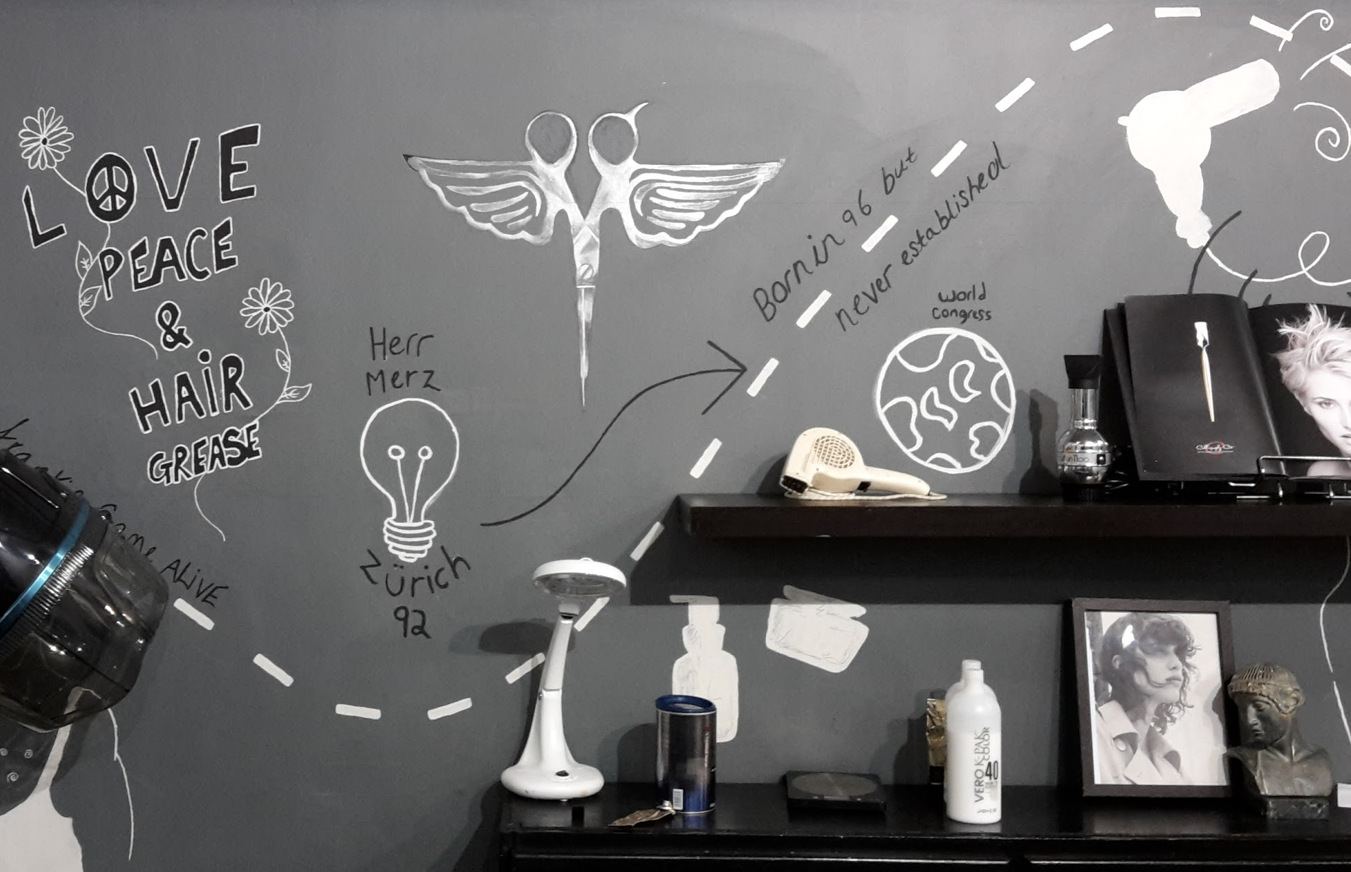
Content Strategy for a hairdresser

Slide 12
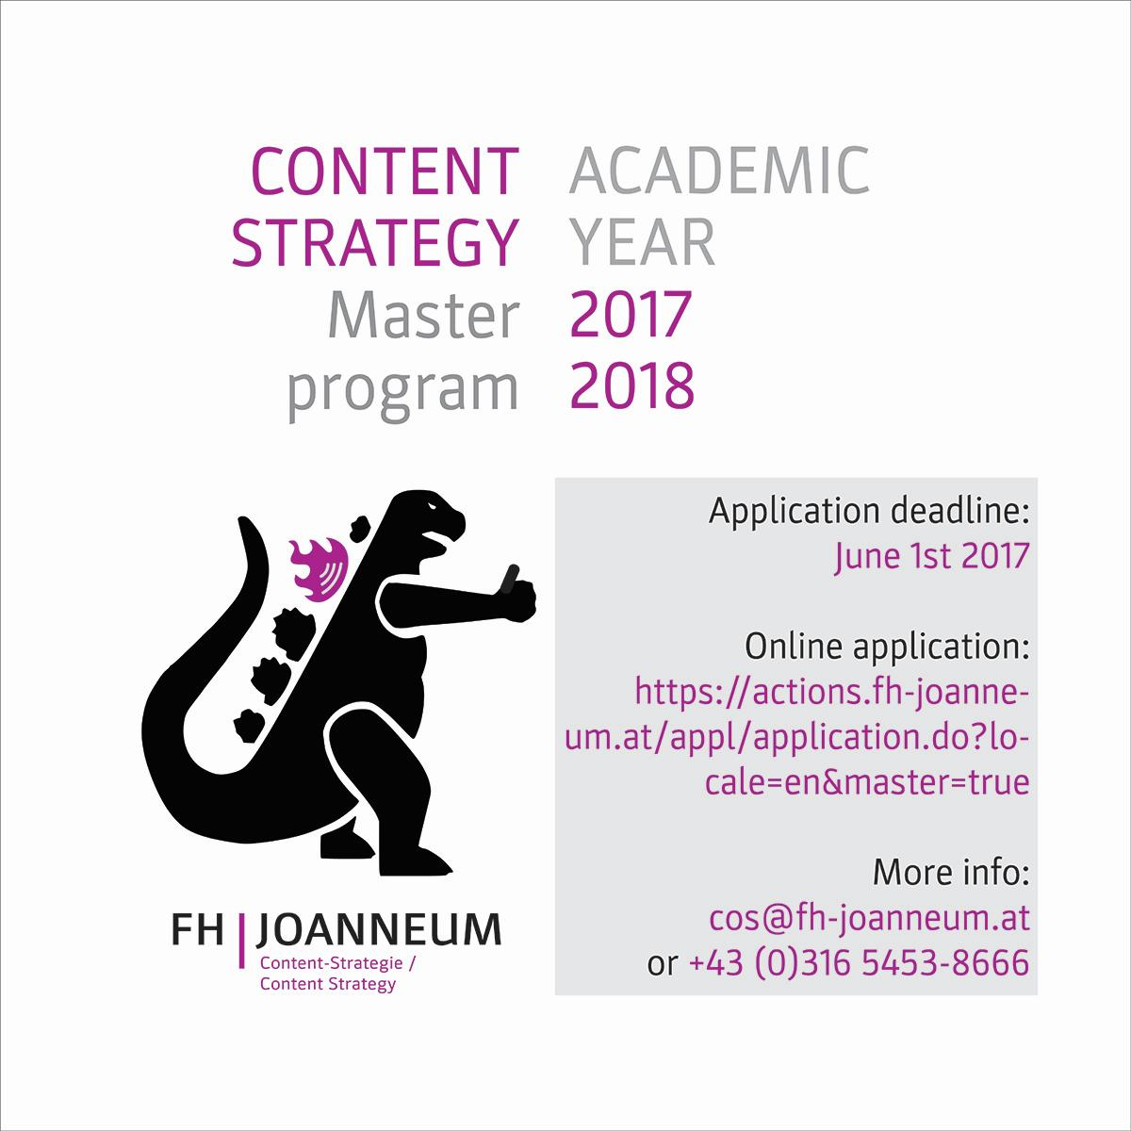
Degree in the
European academic system

Slide 13
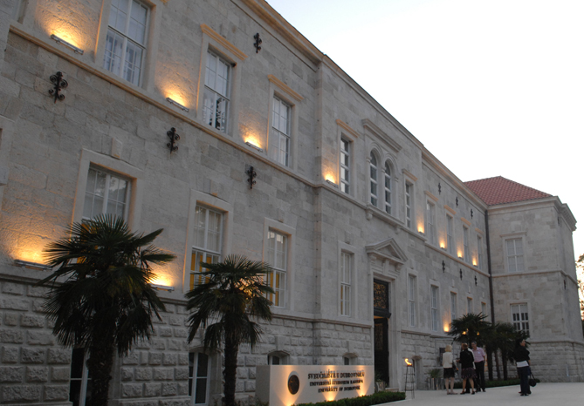
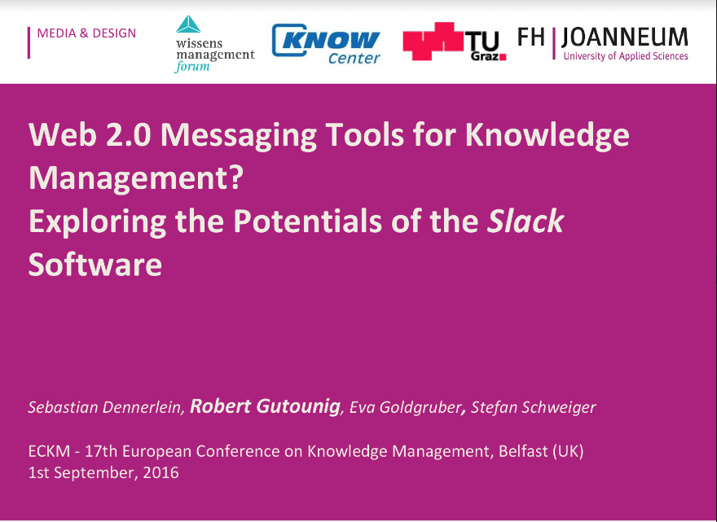
Next: internationalisation, research
Content Strategy Summer School
University of Dubrovmik
Summer 2018

Slide 14
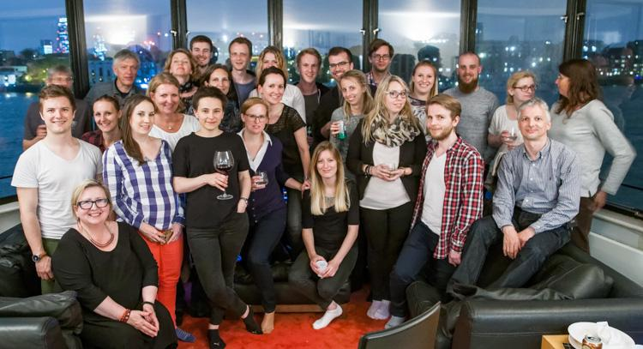
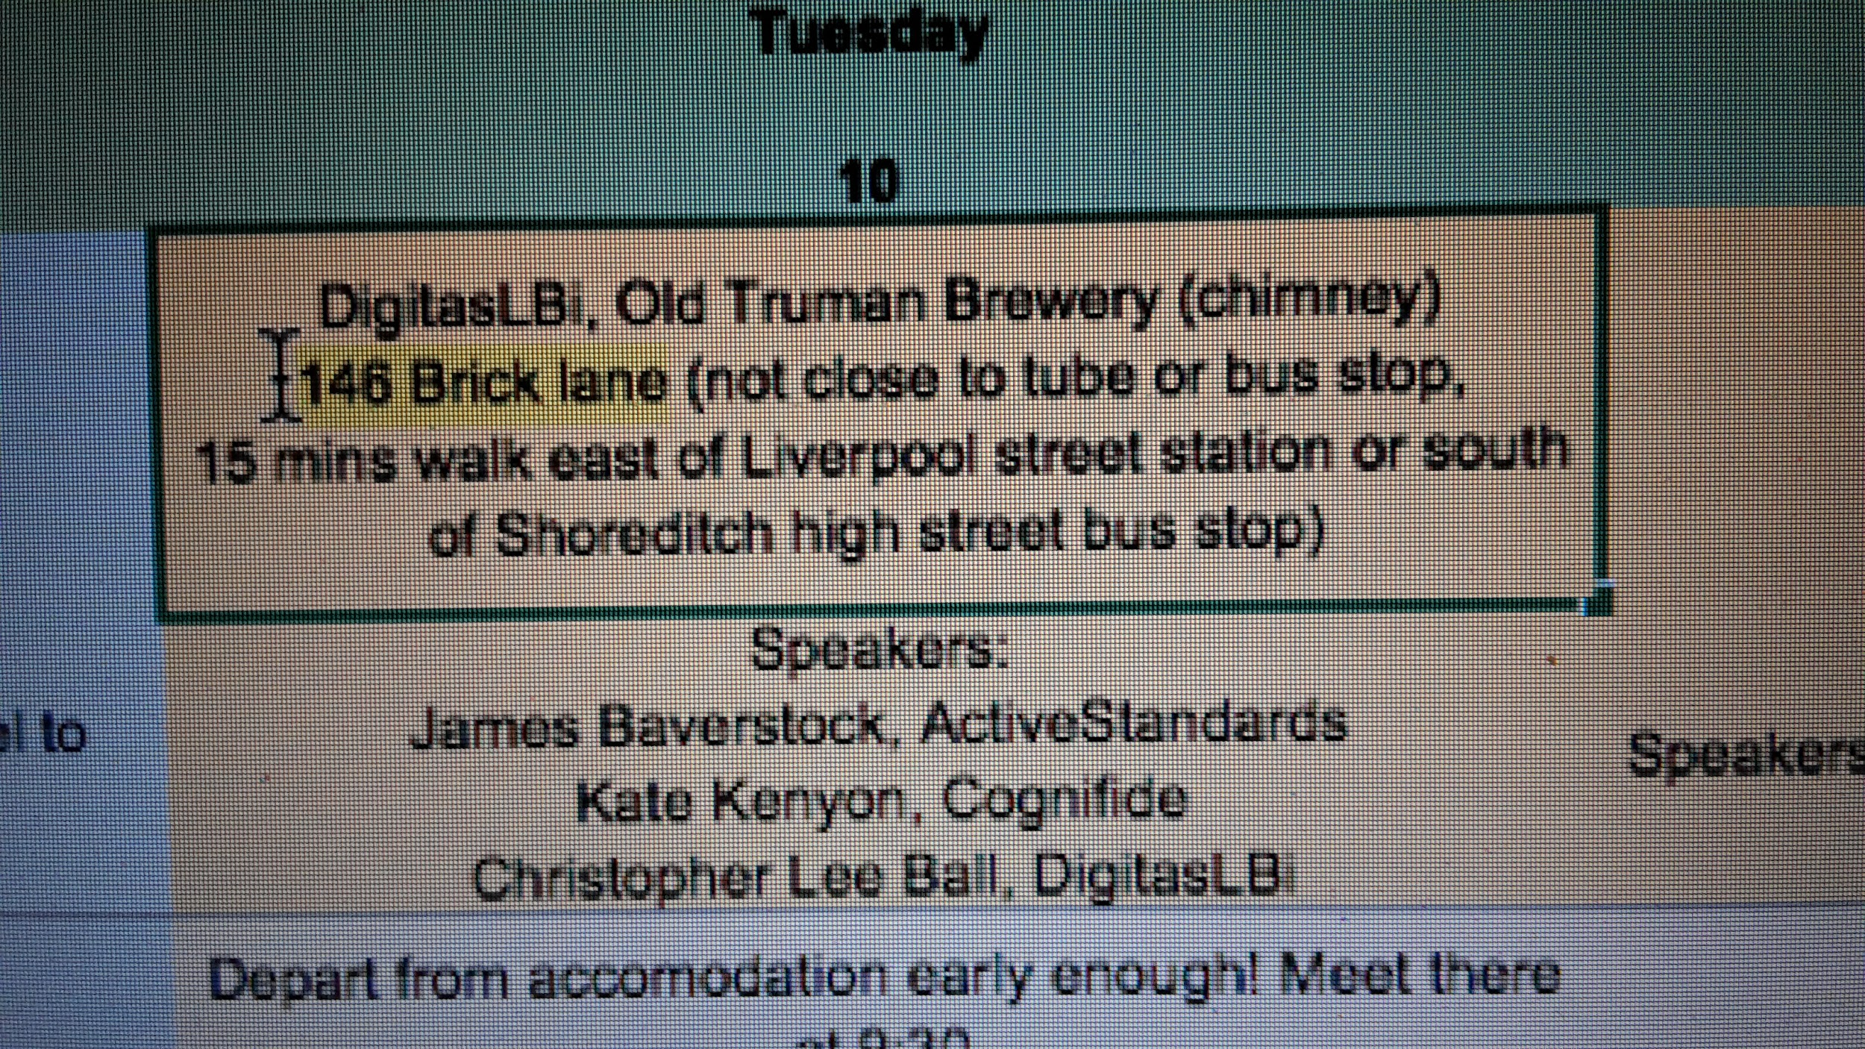
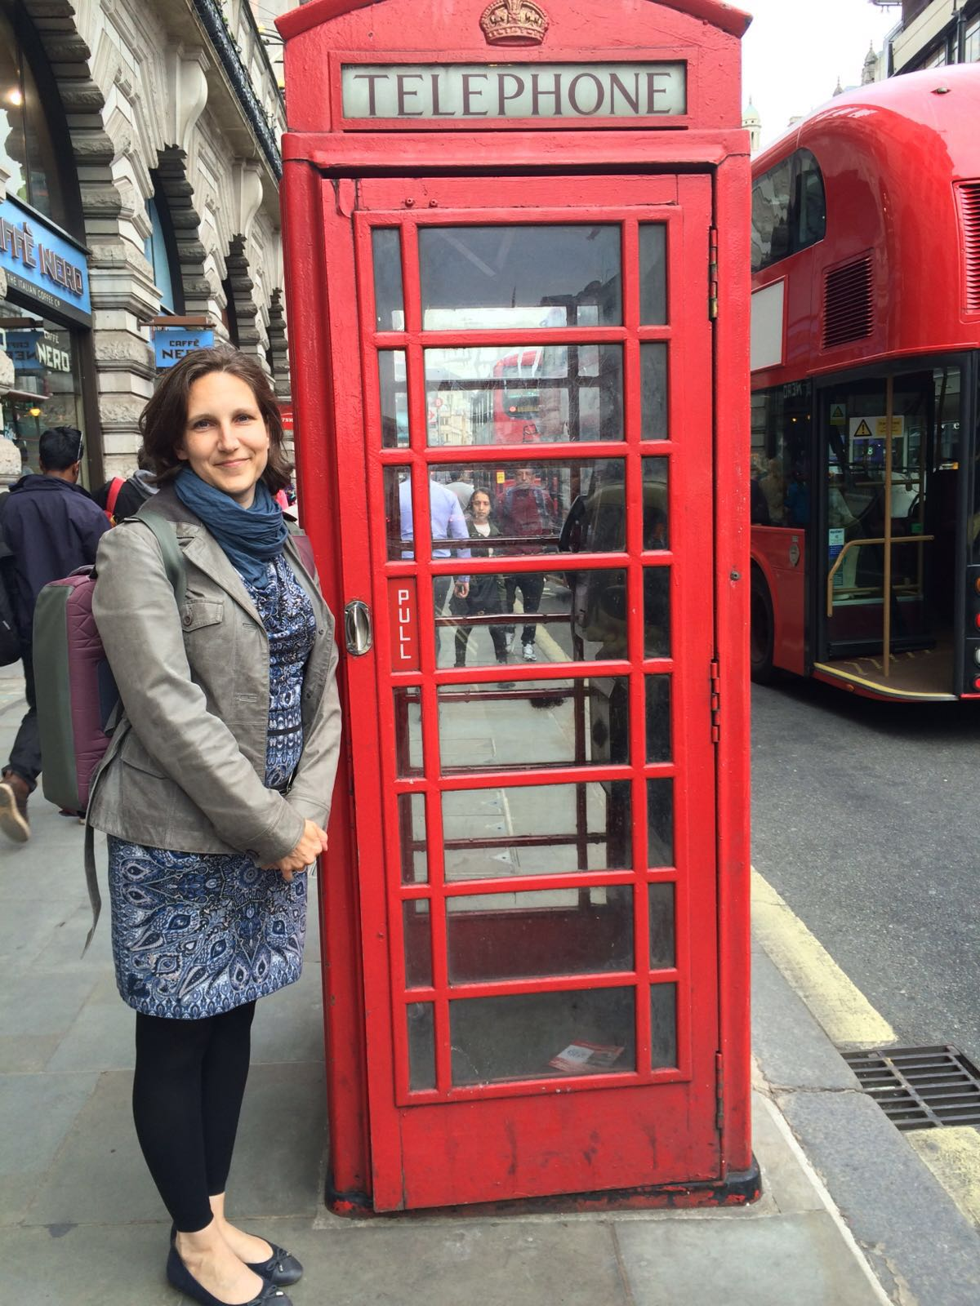
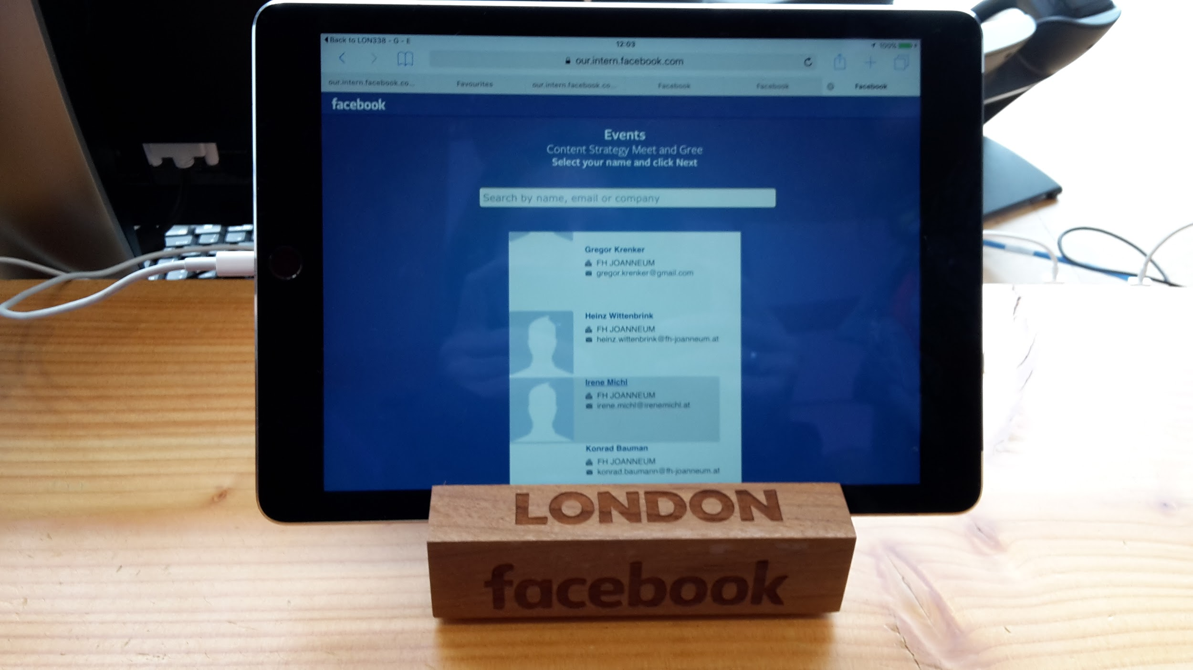
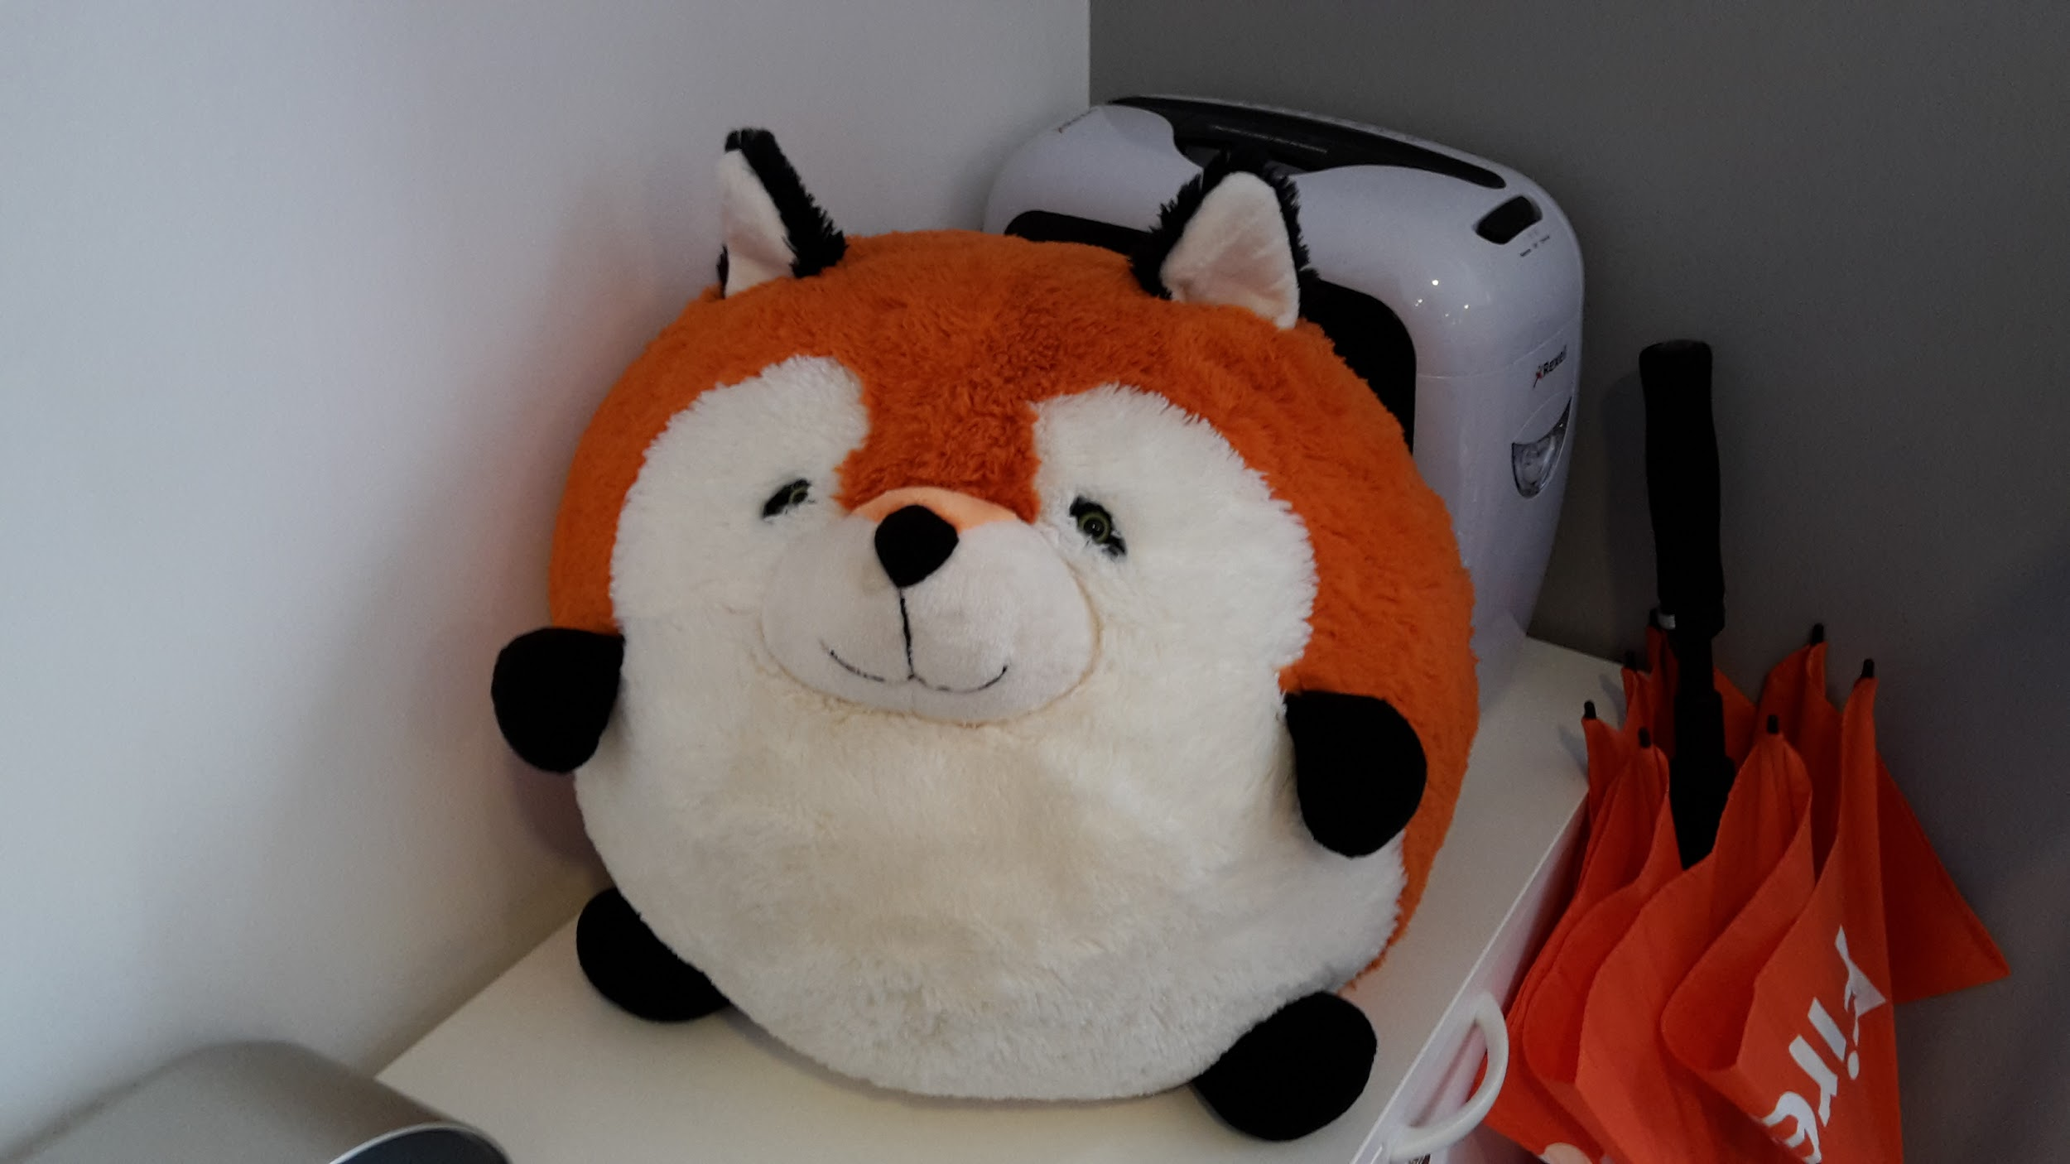
London in May 22 - 26

Slide 15





Join our content strategy community
https://fh-joanneum.at/cos
@ContentGraz
contentstrategie
Heinz Wittenbrink
+43 664 80453 8665
@heinz
heinzwittenbrink
Irene Michl
+43 676 339 12 38
@irenemichl
irenemichl
Content Queen Irene

